Slide 1


Xccelerate.co
Data Science - Statistics II
Topics Covered:
Probability
Joint Probability
Marginal Probability
Conditional Probability
Bayes Theorem
Exercise
Hypothesis testing

Slide 2


Probability
Probability is the science of uncertainty. It provides precise mathematical rules for understanding and analyzing our own ignorance. It does not tell us tomorrow’s weather or next week’s stock prices; rather, it gives us a framework for working with our limited knowledge and for making sensible decisions based on what we do and do not know.
Notes:
https://forms.gle/jnob3YLb33f7Zxcw5 - Feedback form

Slide 3
Let us take a scenario:
You want to buy a lottery ticket in Lotto 6/49. In this lottery, you can pick six distinct numbers between 1 and 49. The lottery company will pick another 6 numbers between 1 and 49. If your ticket matches the lottery company’s ticket exactly, you win the jackpot of $1,000,000. The price to enter a ticket is $1.
What do you think the odds of winning are?
Notes:
https://forms.gle/jnob3YLb33f7Zxcw5 - Feedback form

Slide 4
After sometime you’ll see:
The chance of someone winning the lottery is 1 in 13,983,816. After you learn expected values, you’ll know that you shouldn’t even consider buying a lottery ticket unless the prize is $14,000,000. Even if the prize is $14 million, you then need to consider other players, who wins and will split the prize with you.
Notes:
https://forms.gle/jnob3YLb33f7Zxcw5 - Feedback form

Slide 5
Let us take another scenario:
A friend tells you that he has 3 cards, one red on both sides, one black on both sides, and one red on one side and black on the other. He mixes the three cards and pulls out a card and shows you one side, which is red. He then offers to bet $4 against your $3 that the other side is also red.
Should you take this bet?
Notes:
https://forms.gle/jnob3YLb33f7Zxcw5 - Feedback form

Slide 6
How about another scenario:
You same friend, suggests you flip a fair coin one thousand times. If you can come up with heads at least 600 times, he will pay you $100. If not, you will have to hand him $1.
Do you think you should take this bet?
Notes:
https://forms.gle/jnob3YLb33f7Zxcw5 - Feedback form

Slide 7
In the coming sections, we will learn to understand probability and try to answer the questions presented previously with logic. Let’s get to it.
Notes:
https://forms.gle/jnob3YLb33f7Zxcw5 - Feedback form

Slide 8
Probability Models
A formal definition of probability begins with Sample Space, S.
Sample space is defined as the collection of all possible outcomes of an experiment.
Whao whao! So many new terminologies, let’s take it one step at a time.
Notes:
https://forms.gle/jnob3YLb33f7Zxcw5 - Feedback form

Slide 9
Suppose we are running an experiment of tossing a fair coin 3 times. That’s it. That’s my experiment, just tossing a coin three times. How many outcomes are there, do you think?

Slide 10
There are 8 outcomes to this experiment, let’s list them out.
{H, H, H}, {H, H, T}, {H, T, H}, {T, H, H}, {H, T, T}, {T, T, H}, {T, H, T}, {T, T, T}
Where H represents a head and T represents a tail. So our Sample space is
S = {{H, H, H}, {H, H, T}, {H, T, H}, {T, H, H},
{H, T, T}, {T, T, H}, {T, H, T}, {T, T, T}}

Slide 11
But what does it mean?
It means that whatever outcome we get for our experiment, it will never be anything other than that’s in our Sample space.
Sample spaces can be discrete or continuous, finite or infinite.

Slide 12
Probability measure
Next we need a probability measure for our model. This is to assign numerical values to each event in our experiment. A probability measure, written as P, must have the following properties:
P(A) is always non-negative and between 0 and 1, where A is an event
P(ф) = 0, i.e, if A is the empty set ф, then P(A) = 0
P(S) = 1, i.e. if A is the entire sample space S, then P(A) = 1
P is additive, meaning if A1, A2, … is a countable sequence of disjoint events, then
P(A1 U A2 U …) = P(A1) + P(A2) + …

Slide 13
OK, now that that definition is out of the way
Let’s define probabilities for our toy experiment of flipping a fair coin thrice. Since all 8 outcomes are equally likely, we assign them equal probabilities:
P({HHH}) = ⅛
P({HHT}) = ⅛
P({HTH}) = ⅛
P({THH}) = ⅛
P({TTH}) = ⅛
P({HTT}) = ⅛
P({THT}) = ⅛
P({TTT}) = ⅛

Slide 14
Let’s define probabilities for special cases.
P(Exactly 2 Heads) = P({HHT, HTH, THH}) = ⅜
P(Exactly 2 Tails) = P({HTT, TTH, THT}) = ⅜
P(Atleast 2 Heads) = P({HHH, HHT, HTH, THH}) = ⁴/₈ = ½
And so on.

Slide 15
Let’s get a bit more mathematical
The sample space, S is called a set. Formally, set is a collection of distinct objects. Sets and Probability are analogous in nature. The following are some basic set operations:
Union: Union is the operation in which two sets are combined to create another set where the elements are present in either the first set or the second.
Intersection: This operation creates another set where the elements are present in both the first and second sets.

Slide 16
3. Difference: This operation creates a set where the elements are present in the first set but not in the second set.
4. Complement: This operation creates a set where the elements are not present in the original set.
Notes:
Please explain union, intersection, difference and complement

Slide 17
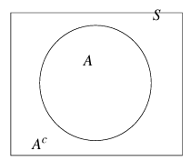
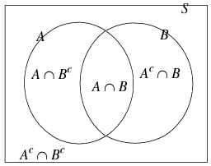
Sets can be visualised with Venn diagrams
Notes:
Please explain union, intersection, difference and complement

Slide 18
Let’s do some exercise
Suppose S= {1, 2, 3} and P({1}) = ⅓, P({2}) = ⅓. Can you answer the following:
What is P({3})?
What is P({1, 2})?
Now suppose S={1, 2, 3} but P({1}) = ½, P({2}) = ⅓, and P({3}) = ⅙. What is the probability P({1, 2, 3})?

Slide 19
Let’s do some more
Suppose S = {1, 2, 3} and P({1, 2}) = ⅓ and P({2, 3}) = ⅔. Compute P({1}), P({2}), and P({3})? [Difficult]
Suppose S is a finite set. Is it possible that P({s}) = 0 for every single s ∊ S. Why or Why not? [Difficult]
Suppose S ={1,2,...,100}. Also suppose that P({1}) = 0.1.
What is the probability P({2,3,4,...,100})?
What is the smallest possible value of P({1,2,3})? [Average]

Slide 20
Suppose we roll eight fair six-sided dice.
(a) What is the probability that all eight dice show a 6?
(b) What is the probability that all eight dice show the same number?
(c) What is the probability that the sum of the eight dice is equal to 9?
Suppose we roll 10 fair six-sided dice. What is the probability that there are exactly two 2’s showing?
Suppose we flip 100 fair independent coins. What is the probability that at least three of them are heads?
Suppose we are dealt five cards from an ordinary 52-card deck. What is the probability that
(a) we get all four aces, plus the king of spades?
(b) all five cards are spades?
(c) we get no pairs (i.e., all five cards are different values)?

Slide 21
Suppose we deal four 13-card bridge hands from an ordinary 52-card deck. What is the probability that
(a)all 13 spades end up in the same hand?
(b) all four aces end up in the same hand?
Suppose we pick two cards at random from an ordinary 52-card deck. What is the probability that the sum of the values of the two cards (where we count jacks, queens, and kings as 10, and count aces as 1) is at least 4?

Slide 22
Let’s Look at another example
Suppose we toss a fair coin and throw a fair dice. What will be the Sample Space? It would look something like this:
 | Heads | Tails
1 | 1/12 | 1/12
2 | 1/12 | 1/12
3 | 1/12 | 1/12
4 | 1/12 | 1/12
5 | 1/12 | 1/12
6 | 1/12 | 1/12

Slide 23
Can you see why it would look like this?
This is called joint distribution. Each cell represents the probability of an event occurring jointly. For example, the first cell represents the probability of a head turning up and the dice showing 1. It is denoted as P(1, Heads).
 | Heads | Tails
1 | 1/12 | 1/12
2 | 1/12 | 1/12
3 | 1/12 | 1/12
4 | 1/12 | 1/12
5 | 1/12 | 1/12
6 | 1/12 | 1/12

Slide 24
We can add up each row and each column
These are called marginal probabilities, where they simply represent the probability of one event occurring without the influence of the other.
 | Heads | Tails | Marginals
1 | 1/12 | 1/12 | P({1}) = 1/6
2 | 1/12 | 1/12 | P({2}) = 1/6
3 | 1/12 | 1/12 | P({3}) = 1/6
4 | 1/12 | 1/12 | P({4}) = 1/6
5 | 1/12 | 1/12 | P({5}) = 1/6
6 | 1/12 | 1/12 | P({6}) = 1/6
Marginals | P({Heads}) = 1/2 | P({Tails}) = 1/2 | 1

Slide 25
Now let us consider only part of the table here:
 | Heads | Tails
1 | 1/12 | 1/12 | P({1}) = 1/6
2 | 1/12 | 1/12 | P({2}) = 1/6
3 | 1/12 | 1/12 | P({3}) = 1/6
4 | 1/12 | 1/12 | P({4}) = 1/6
5 | 1/12 | 1/12 | P({5}) = 1/6
6 | 1/12 | 1/12 | P({6}) = 1/6
 | P({Heads}) = 1/2 | P({Tails}) = 1/2 | 1

Slide 26
If we look at this table, these can be considered to be the probabilities of the events when Heads occurs in the toss. We can consider them to be a condition of when Heads has already occurred.
 | Heads
1 | 1/12
2 | 1/12
3 | 1/12
4 | 1/12
5 | 1/12
6 | 1/12

Slide 27
But these don’t add upto 1, since they are only part of the whole sample set. But since we are restricting our observation to this set, we can normalize this table to add upto 1.
 | Heads
1 | 1/12
2 | 1/12
3 | 1/12
4 | 1/12
5 | 1/12
6 | 1/12

Slide 28
And it would look like this. This is called conditional probability, and is denoted as P(1|Heads).
P(1|Heads) | 1/6
P(2|Heads) | 1/6
P(3|Heads) | 1/6
P(4|Heads) | 1/6
P(5|Heads) | 1/6
P(6|Heads) | 1/6

Slide 29
Now let us consider a slightly more difficult example
Suppose we have one coin, and we toss it twice. What will the Joint distribution table look like? Try to create it on your own.

Slide 30
It would look something like this:
 | Heads | Tails
Heads | 1/4 | 1/4
Tails | 1/4 | 1/4
Does yours look like this?

Slide 31
Suppose we have one coin, and we toss it thrice. How can we figure out the probability of P(first coin is heads| two coins are head)? Please work this out.

Slide 32
S={HHH, HHT, HTH, THH, THT, TTH, HTT, TTT}
S’={HHT, HTH, THH} (Two coin heads)
P(First head | Two Heads) = ⅔
Did you work it out?

Slide 33
In General, for two events A and B, with P(B) > 0, the conditional probability of A given B is equal to
P(A|B) = P(A⋂B)/P(B)

Slide 34
S={HHH, HHT, HTH, THH, THT, TTH, HTT, TTT}
Revisiting the same problem, we can assume
Event A = First Head
Event B = Two Heads
P(A⋂B) = 2/8
P(B) = 3/8
P(A|B) = 2/3

Slide 35
Let’s solve some conditional probabilities:
Suppose that we roll four fair six-sided dice.
(a) What is the conditional probability that the first die shows 2, conditional on the event that exactly three dice show 2?
(b) What is the conditional probability that the first die shows 2, conditional on the event that at least three dice show 2?
Suppose we flip two fair coins and roll one fair six-sided die.
(a) What is the probability that the number of heads equals the number showing on the die?
(b) What is the conditional probability that the number of heads equals the number showing on the die, conditional on knowing that the die showed 1?
(c) Is the answer for part (b) larger or smaller than the answer for part (a)? Explain intuitively why this is so.

Slide 36
Suppose we flip three fair coins.
(a) What is the probability that all three coins are heads?
(b) What is the conditional probability that all three coins are heads, conditional on knowing that the number of heads is odd?
(c) What is the conditional probability that all three coins are heads, given that the number of heads is even?

Slide 37
Now let’s revisit our friend’s card game. Could we solve it now? We know that each card has 2 sides. One card has 2 red sides, one has 2 black sides, and one has one red and one black sides. Given that the friend pulled out a card with one red side, what is the probability that the other side is also red?
Conversely, can you work out the probability of seeing a black side and the other side being red?

Slide 38
Now let us consider the following cases:
Suppose we want to find the Probability of an event A given another event B. We can write it as:
P(A|B) = P(A⋂B) / P(B) (1)
And another scenario where we want to find the probability of event B given event A. We can write it as:
P(B|A) = P(B⋂A)/P(A) (2)
From set theory, we know that (A⋂B) = (B⋂A). Thus we can say P(A⋂B) = P(B⋂A). Then from (1) and (2) above we have:
P(A|B) P(B) = P(B|A)P(A)
Or, P(A|B) = (P(B|A)P(A)) / P(B) This is also called Bayes Theorem.

Slide 39
Now let’s try to answer this question:
Suppose urn#1 has 3 red and 2 blue balls, and urn#2 has 4 red and 7 blue balls. Suppose one of the two urns is selected with probability ½ each, and then one of the balls within that urn is picked uniformly at random. What is the probability that urn#2 is selected at the first stage (eventA) and a blue ball is selected at the second stage (eventB)?
Let’s say event A = Picking urn#2
And event B = Picking a blue ball
Then event B|A = Picking a blue ball given we picked urn#2
P(A) = 1/2 and P(B | A) = 7/11
So P(A⋂B) = P(B|A)*P(A) = 1/2 * 7/11 = 7/22

Slide 40
Now let us consider the probability of picking a blue ball. That would be picking urn#1 then picking a blue ball, or urn#2 then picking a blue ball. We can write that as-
P(B) = (1/2*2/5) + (1/2*7/11) = 1/5 + 7/22 = 57/110
Given all the above information, can we find out the probability of picking urn#2 given we picked a blue ball.
We consider event A|B = Picking urn#2 given we picked a blue ball
P(A|B) = P(A⋂B) / P(B)
P(A|B) = (7/22) / (57/110) = 35/57
Also from Bayes theorem, we have
P(A|B) = (P(A)P(B|A))/P(B) = ((1/2)(7/11))/(57/110) = 35/57

Slide 41
What did we learn from the previous observation?
The marginal probability of picking urn#2 is 0.5. But if we know that a blue ball was picked, the probability of picking urn#2 increases significantly (0.614). This makes sense because urn#2 has more blue balls than red. So if we are able to randomly pick a blue ball, the chances are we are picking it from urn#2.

Slide 42
Now for the fun part: More exercises!
Suppose the probability of snow is 20%, and the probability of a traffic accident is 10%. Suppose further that the conditional probability of an accident, given that it snows, is 40%. What is the conditional probability that it snows, given that there is an accident?
Suppose we are playing poker with one opponent from a standard deck of 52 cards. We both have 5 cards in our hands. We see that we have 3 spades in our hand. What is the probability that our opponent has no spades in their hand, given we have 3 spades?

Slide 43
Suppose we roll three fair six-sided dice. Compute the conditional probability that the first die shows 4, given that the sum of the three numbers showing is 12.
(The Monty Hall problem) Suppose there are three doors, labeled A, B, and C. A new car is behind one of the three doors, but you don’t know which. You select one of the doors, say, door A. The host then opens one of doors B or C, as follows: If the car is behind B, then they open C; if the car is behind C, then they open B; if the car is behind A, then they open either B or C with probability 1/2 each. (In any case, the door opened by the host will not have the car behind it.) The host then gives you the option of either sticking with your original door choice (i.e., A), or switching to the remaining unopened door (i.e., whichever of B or C the host did not open). You then win (i.e., get to keep the car) if and only if the car is behind your final door selection.

Slide 44
(a) If you stick with your original choice (i.e., door A), conditional on the host having opened door B, then what is your probability of winning?
(b) If you switch to the remaining door (i.e., door C), conditional on the host having opened door B, then what is your probability of winning?
(c) Do you find the result of parts (a) and (b) surprising? How could you design a physical experiment to verify the result?
Suppose you are able to repeat an experiment many times, and you wish to check whether or not two events are independent. How might you go about this?

Slide 45
Let us turn our attention to the coin dice experiment we ran earlier. We tossed a coin and then throw the dice. Do you think the coin influences the dice throw somehow? In other words, is it possible that the outcome of one event increases or decreases the probability of the other one? In our previous experiment we concluded that if we know that the ball we pulled out is blue, it means we had a higher chance of picking urn#2. Can we say anything about the probability of the dice turning up 3 increases if we have a head in the toss?

Slide 46
Independence of Events
Let event A = heads
And event B = dice 3
P(A) = 1/2 and P(B) = 1/6
P(B|A) = P(A∩B)/P(A) = (1/12) / (1/2) = 1/6
So we have P(B|A) = P(B).
So the event A has no influence on the outcome of B.
P(B|A) = P(B)
P(A∩B)/P(A) = P(B)
P(A∩B) = P(A)P(B)
Here A and B are independent events.

Slide 47
Quick summary of conditional probabilities
Conditional probability measures the probability that A occurs given that B occurs; it is given by P(A| B) = P(A ∩ B)/P(B).
Conditional probability satisfies its own law of total probability. (Conditional Probabilities add up to 1)
Events are independent if they have no effect on each other’s probabilities. Formally, this means that P(A ∩ B) = P(A)P(B).
If A and B are independent, and P(A)>0andP(B)>0, then P(A|B) = P(A) and P(B| A) = P(B)

Slide 48
Independence of Events - Exercise
Suppose we roll two fair six-sided dice, one red and one blue. Let A be the event that the two dice show the same value. Let B be the event that the sum of the two dice is equal to 12. Let C be the event that the red die shows 4. Let D be the event that the blue die shows 4.
(a) Are A and B independent?
(b) Are A and C independent?
(c) Are A and D independent?
(d) Are C and D independent?
(e) Are A, C,and D all independent?

Slide 49
Now that we know the basics of Probability and Statistics
Let’s think of a case where a neurologist is testing the effects of a drug she developed, on the response time of rats. She injected 100 rats with a unit dose of the drug, and subjected each to a neural stimulus. She recorded the response times of each rat. She knows that the mean response time for rats without the drug is 1.2 seconds. The mean response of the 100 rats is 1.05 seconds with a standard deviation of 0.5 seconds. Do you think the drug has an effect?

Slide 50
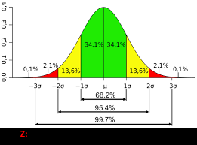
Introducing statistical tests
We can determine if the drug actually introduced any changes to the rat’s response time by performing statistical test on the data. Basically we try to find the probability of the new mean’s deviation from the original mean.
Recall that a normal distribution looks like this:

Slide 51
Hypothesis testing
So let us come up with a hypothesis. The default hypothesis would be that the drug has no effects. We call this the null hypothesis, denoted as H₀.
H₀: Drug has no effect.
And our other/alternative hypothesis would be that the drug has some effect.
H₁: Drug has effect.
So if the drug has no effect then the new mean should have very high probability of being near the original mean.
Let us approximate the sampling distribution standard deviation using our population standard deviation. Since our sample size is large enough, we can approximate the sampling distribution standard deviation σ = population standard deviation/√N. N = 100, in our case.

Slide 52
So σ_{x}=0.5/√100 = 0.05
We can now convert the difference between the two means into z value.
z = (1.05-1.2)/0.05 = -3
We can then calculate the probability of the z value by considering the normal distribution curve.
P-value = P(|z|>=3) = 0.3%
Since the p-value is less than 5%, we reject the null hypothesis and conclude that H₁ must be true.

Slide 53
Tail tests
In our previous example, we found out what the probability of z was below -3 and above +3, denoted by P(|z| >= 3). This is called a two tailed test, as we are considering both side of the normal distribution.
We can also perform a one tailed test, where we only consider one side of the normal distribution.
We can calculate this by P(z <= -3) = 0.15%. Even with our one tailed assumption, we can see that the probability is still very low (as compared to 2.5%). Hence, we still reject the null hypothesis.

Slide 54
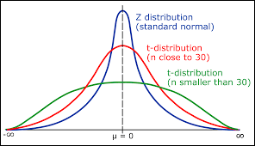
Z-statistics vs T-statistics
When we have a large sample size, typically greater than 30, we can assume normal distribution and calculate the Z-statistics as we looked in our previous slides.
But if our sample size is smaller than 30, we approximate it by a t-distribution.
On the right side, we see how t-distribution
gradually tends to be normal distribution with
increasing n.

Slide 55
Sample t-test
The mean emission of all engines of a new design needs to be below 20ppm if the design is to meet new emission standards. 5 engines are manufactured for testing and the emission levels are determined to be:
15.6, 16.4, 19.4, 20.5, 13.9
Does our data supply enough evidence to support the hypothesis that the new engine design meet the new standards?

Slide 56
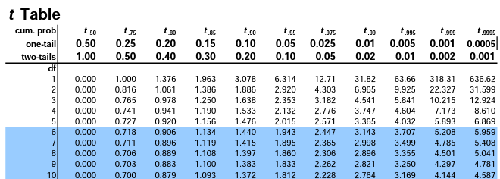
Let calculate the population mean and standard deviation:
X_mean = (15.6 + 16.4 + 19.4 + 20.5 + 13.9)/5 = 17.16
s = 2.73
H₀: Don’t meet the standards, mean = 20ppm (受小
H₁: We meet the standards, mean < 20ppm
Assuming H₀ is true. We calculate the t-value as following:
t = (17.16 - 20)/(2.73/√5) = -2.32
We lookup the t-statistic for degrees of freedom = (5 - 1) = 4. We see that we have a < 5% probability that t = -2.132 > -2.32. Depending on our error tolerance, we can accept or reject the null.

Slide 57
Chi-Squared Test [𝝌²]
This kind of test is used to determine similarities between different distributions. Let us consider the following data:
We want to know the distribution of customers at a restaurant. The owner of the restaurant says he already figured it out and it’s like this.
T | W | T | F | S | S | Days
10 | 10 | 15 | 20 | 30 | 15 | Owner’s distribution (in percent)
30 | 14 | 34 | 45 | 57 | 20 | Our Observation (=200)
20 | 20 | 30 | 40 | 60 | 30 | Owner’s distribution (in amount)
We were suspicious about the owner’s honesty, so we want to test the

Slide 58
distribution on our own. So we collected some data by visiting the restaurant. We then have the owner’s distribution in numbers according to their percentages. We want to know if these two distributions are significantly alike. And we want an error tolerance of 5%(or 0.05).
Our hypotheses are as follows:
H₀: The owner’s distribution is correct
H₁: The owner’s distribution is incorrect
Let’s compute the 𝝌² statistics = (30-20)²/20 + (14-20)²/20 + (34-30)²/30 + (45-40)²/40 + (57-60)²/60 + (20-30)²/30
=5+1.8+0.53+0.625+0.15+3.33
=11.44

Slide 59
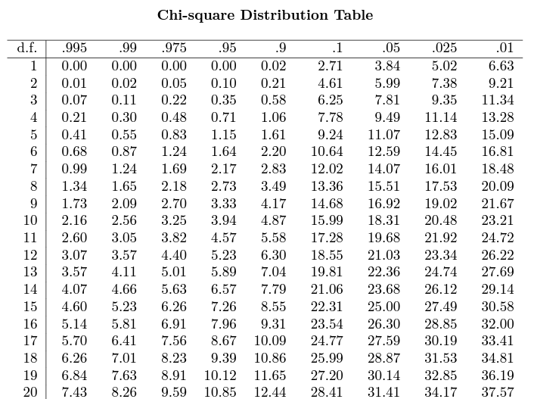
We should now find the degrees of freedom, which n-1, where n is the number of dimensions of our data. So d.f. = 5 in our case. We now consult the chi-square table to find the critical value of d.f.=5 and significance level of 5% (also called tolerable error).
From our chi-square table, we can see that for d.f. 5, and significance level 0.05, the critical value is 11.07, which is smaller than 11.44. So 11.44 lies in even smaller probability. We can then safely reject the null, and conclude that the distributions are different.

Slide 60
Let’s see another example
In an exam, we have 4 options to choose from. The distribution of correct answers for each question should be equally likely among the 4 options. But you think there might be a pattern to the distribution and it might be skewed towards some options more than others. You run an experiment where you collect the answers for 100 questions and tabulated the results.
Options | Optimal Dist | Your Obs
A | 25 | 20
B | 25 | 20
C | 25 | 25
D | 25 | 35

Slide 61
In your observations, you see a skew towards options C and D and you want to determine if it’s significant or was this only true for the 100 questions you selected. To test this, we need to compute the chi-squared statistic.
𝝌² statistics = (20-25)²/25+(20-25)²/25+(25-25)²/25+(35-25)²/25 = 6
And our D.f. = 4-1 = 3 (categories - 1). Suppose we also determine that we want our significance level to be 0.05 (or 5% Error).
H₀: Equal distribution
H₁: Skewed distribution
When we consult the Chi-square table,
We can observe that the critical value is 7.81 which is greater than 6. So in this case we cannot reject the null hypothesis.

Slide 62
F-Test
F statistics test is used to test correlation between multiple random variables. Consider the example, where we run a test with 3 food items on 5 participants. We want to measure their performance score on some criteria which we can represent in the following table.
 | Food 1 | Food 2 | Food 3
Person 1 | 3 | 5 | 6
Person 2 | 2 | 3 | 5
Person 3 | 2 | 5 | 6
Person 4 | 1 | 4 | 6
Person 5 | 3 | 4 | 7

Slide 63
For this test, we compute the different means of each data points. So
Ū₁ = (3+2+2+1+3)/5 = 2.2
Ū₂= (5+3+5+4+4)/5 = 4.2
Ū₃= (6+5+6+6+7)/5 = 6
These are the mean performance score for each food item. And
U̿ = (2.2 + 4.2 + 6) / 3 = 4.133
This is the mean of means. So we then ask the question does our data support the fact that there is actually a difference in the performance of different foods or do our means vary just by chance. To find this, we compute three metrics, which is used to determine the F-test scores. Let’s see how it’s done.

Slide 64
First we compute Sum of Squares Residues Total (SST).
SST =
(3-4.13)²+(5-4.13)²+(6-4.13)²+(2-4.13)²+(3-4.13)²+(5-4.13)²+(2-4.13)²+(5-4.13)²+(6-4.13)²+(1-4.13)²+(4-4.13)²+(6-4.13)²+(3-4.13)²+(4-4.13)²+(7-4.13)²
= 81.36
Next we compute Sum of Squares Residues Within(SSW).
SSW =
(3-2.2)²+(5-4.2)²+(6-6)²+(2-2.2)²+(3-4.2)²+(5-6)²+(2-2.2)²+(5-4.2)²+(6-6)²+(1-2.2)²+(4-4.2)²+(6-6)²+(3-2.2)²+(4-4.2)²+(7-6)²
= 7.6

Slide 65
Finally we compute Sum of Squares Residues Between(SSB).
SSB =
(2.2-4.13)²+(4.2-4.13)²+(6-4.13)²+(2.2-4.13)²+(4.2-4.13)²+(6-4.13)²+(2.2-4.13)²+(4.2-4.13)²+(6-4.13)²+(2.2-4.13)²+(4.2-4.13)²+(6-4.13)²+(2.2-4.13)²+(4.2-4.13)²+(6-4.13)²
= 36.13
We also need to determine the degrees of freedom for each metric. So general rule of thumb for m-categories (3 in our case) and n-observations(5 in our case) in each category,
D.f SST = mxn-1 = 3x5 - 1 = 14
D.f. SSW = mx(n-1) = 3x4 = 12
D.f. SSB = m-1 = 2

Slide 66
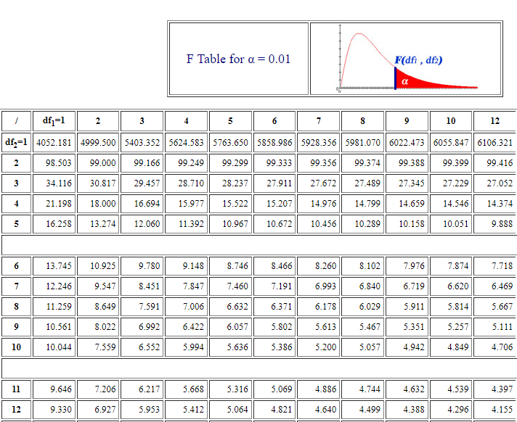
Then F statistics is defined as-
F = (SSB/D.f of SSB) / (SSW/D.f of SSW)
We then hypothesize that
H₀: Food doesn’t make a difference => Ū₁ = Ū₂= Ū₃
H₁: Food does make a difference
Assuming H₀ is true with a significance
level of 0.01 (or 1%).
F-statistics = (36.13/2)/(7.6/12) = 28.52
From the F Table for significance 0.01,
We can see the critical value is 6.9.
Which is very less than our result of 28.52.
So we reject the null hypothesis.

